Slide 1
Quantitative Likert Data Analysis for Honors Capstone
David D. Salamoun

Slide 2


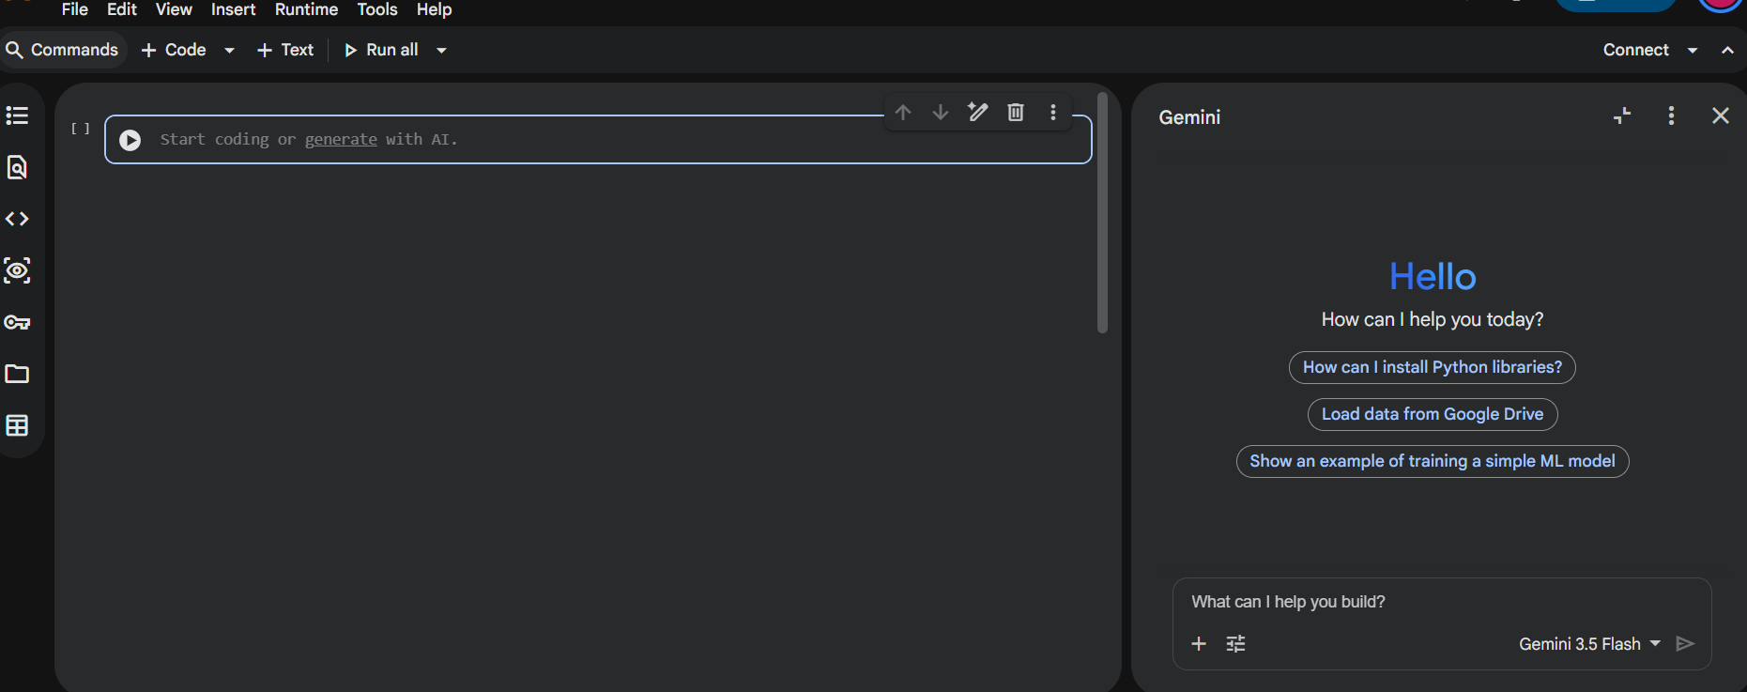

Slide 3
Terminologies and
Data Literacy

Slide 4
Terminologies
Must Know
Descriptive Statistics: Application of showing statistical features/central tendancy related to numerical data
Frequency Distribution: Application of showing frequency (%) and counts (n) for categorical groups, and sub-groups
Groups: Members of a demographic or response
Likert Scale: Ordinal rating that uses integers ranging from 1 to 4 OR 1 to 5 OR 1 to 7 OR 1 to 9 to display intensity
Construct: Group of Likert Scale questions that can explain a phenomenon/construct; you can conduct an average rating.
Normal Data: Numeric Data that display Bell-shape curve with no/minimal Skewness nor Kurtosis where mean~=median=~mode
Mode: Most repeated data seen
Standard Deviation: How data is different from the mean in normal data
Skewness: How numeric Data tend to move to extreme sides such as right or left
Kurtosis: How numeric Data tend to move up or down
Non-normal Data: Can be Likert-scale or numeric data that violates the normality mentioned
IQR: It is when we select 75th percentile of the data minus 25th percentile of the data, to get a range for non-normal data
Median: Middle man of the data representing 50th percentile
Hypothesis Testing: Tests for Statistical difference between groups
Significance (alpha): A percentage set at 10%, 5%, or 1%; p-value is calculated, aimed to be below these %.
Power(beta): Probability of being correct on what is real, eg. saying that these groups are really not similar
(power analysis).
Correlation: Relationship between numeric, categorical, or Likert scale data that can show a trend

Slide 5
Types of variables

Slide 6
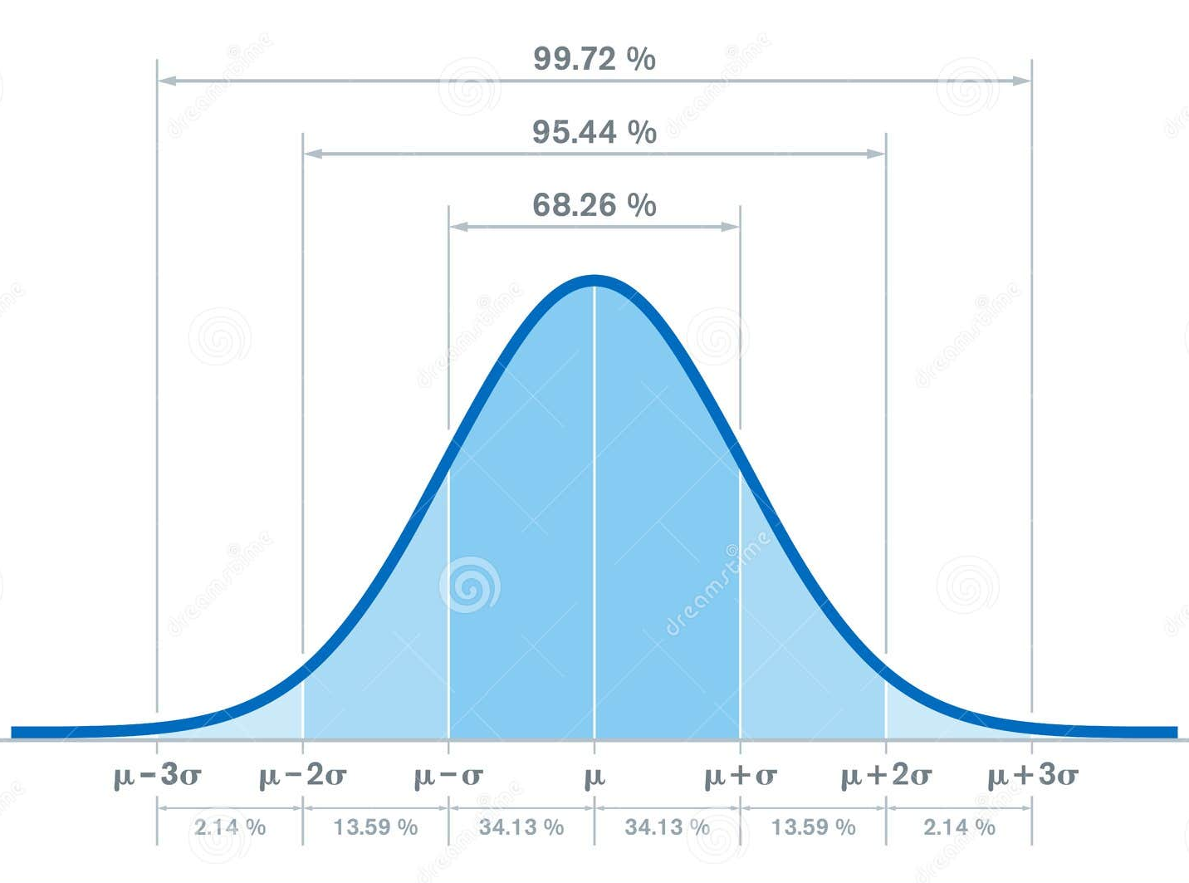
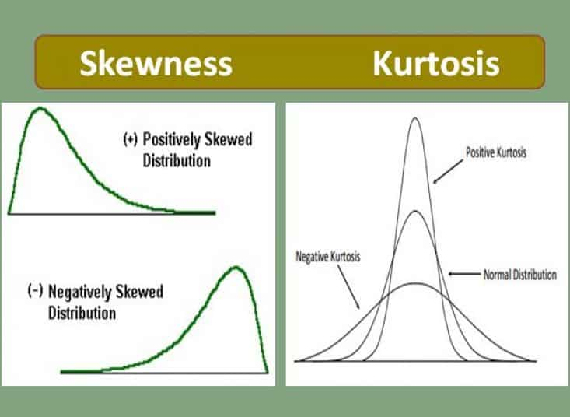
Distribution of Numeric Data e.g. 1, ½, 1.05, 145, 145.5
mode
median
mean
x
mode
median
mean
x
Bell Curve
Skewness
Kurtosis
Bell curve distributions can use parametric tests
Skewness score ranges from -0.5 to +0.5
Kurtosis score ranges from -2 to +2
If these are not satisfied, the numeric data are non-normal and require non-parametric tests. Rely on median and IQR
Still, we could do data transformation to make it normal, but it can fail and will not be explained any further in this session.

Slide 7
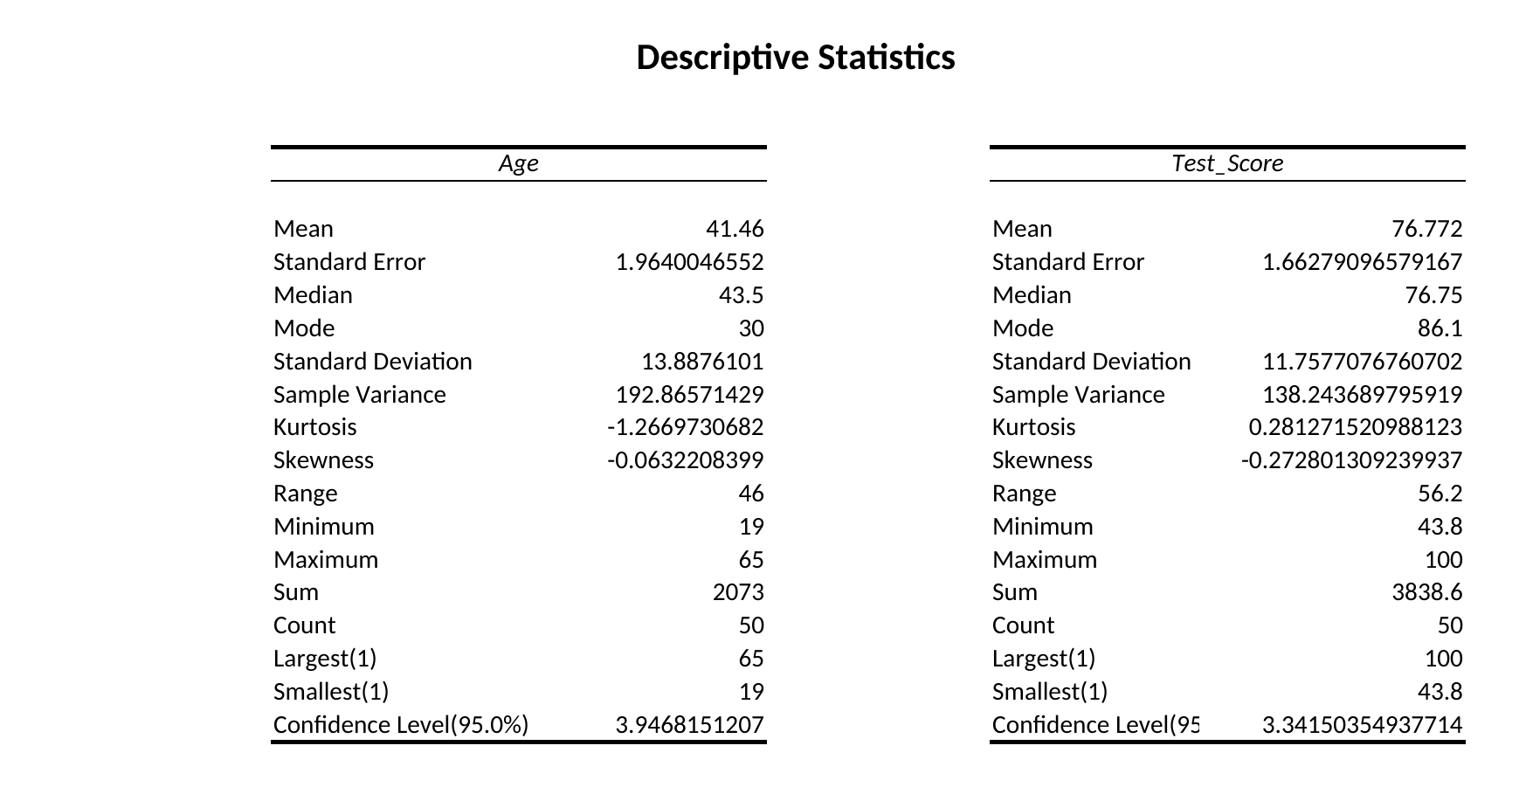
Excel: Descriptive Statistics (Mean, SD)
Data Analysis ToolPak › Descriptive Statistics on Age and Test_Score
Source: Completed Work.xlsx, sheet Descriptives_Data (ToolPak output)

Slide 8
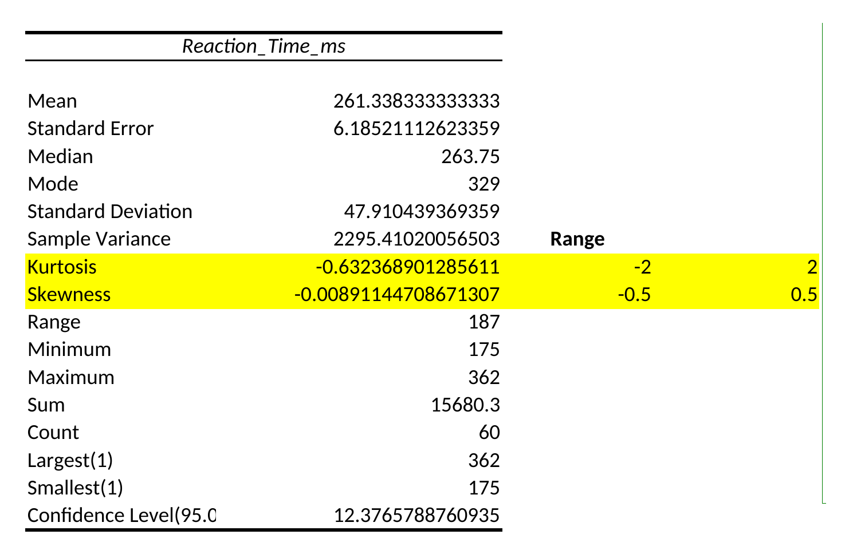
Excel: Normality (Skewness, Kurtosis) Not needed for project
ToolPak skewness and kurtosis checked against the ±0.5 and ±2 cut-offs (highlighted)
Anderson–Darling test
Not significant? Good, Data is normal
Source: Completed Work.xlsx, sheet Independent_Groups_Data (ToolPak output)

Slide 9
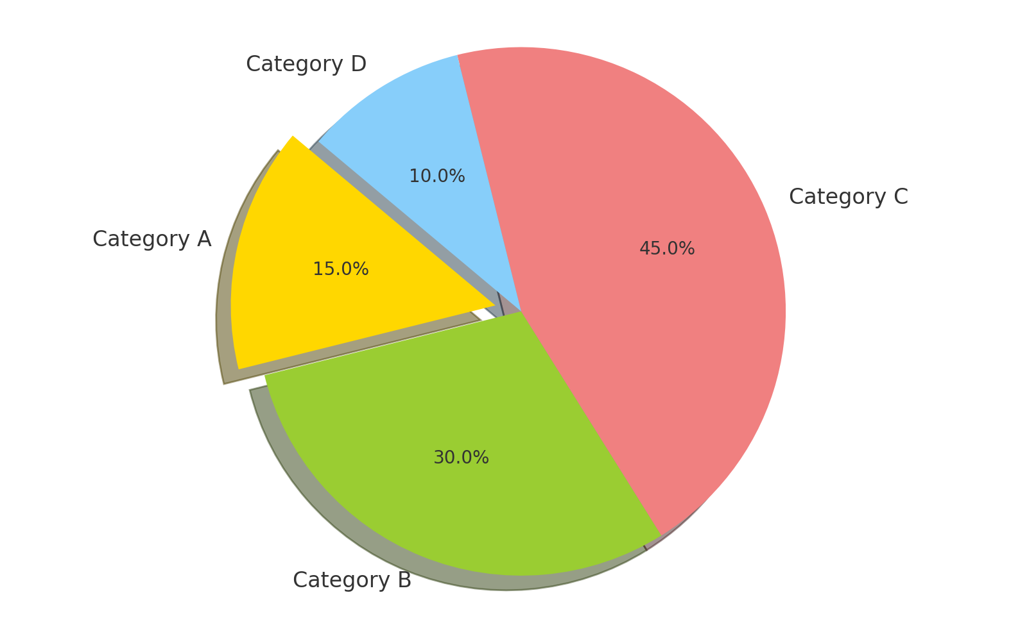
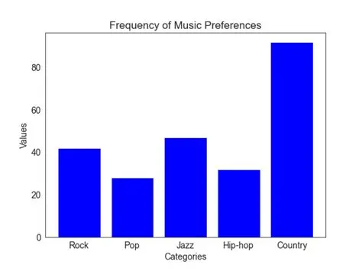
Distribution of Categorical Data
We can also label groups with integers
Ex: Male = 0 and Female = 1 when advanced analysis is needed
5 categories is your max, not more or use different chart
Frequency in % (pie chart)
Counts (n) (vertical bar chart)
We will build a frequency distribution table

Slide 10
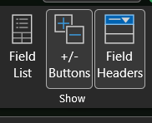
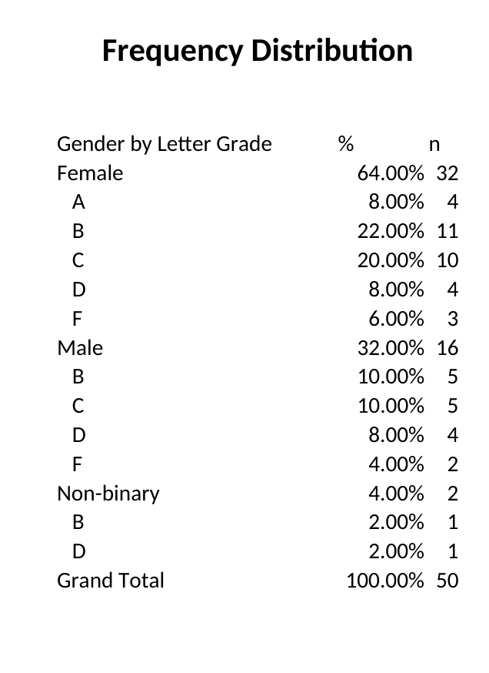
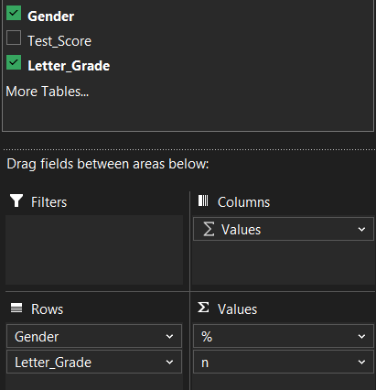
Excel: Frequency Distribution (n, %)
PivotTable on Gender by Letter Grade, with % of Grand Total and counts
Source: Completed Work.xlsx, sheet Descriptives_Data (PivotTable)

Slide 11
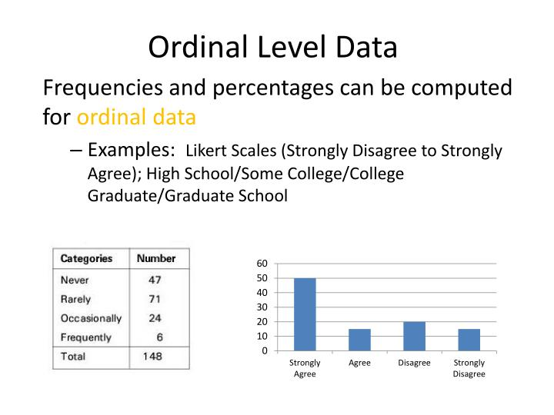
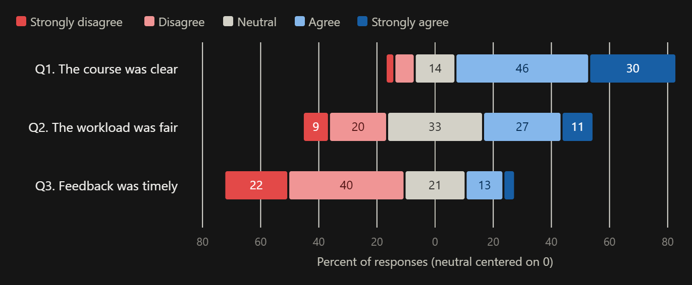
Distribution of Ordinal Data (Likert Scale)
Horizontal, stacked bar chart
Can be converted from 1 to 4 for intensity (integers) e.g. 1, 2, 3
1 to 4 has no neutral option, unlike 1 to 5, where “3” is neutral
Used for rating and has properties of categories and numeric, but with a direction and intensity
Non-normal data but we can use mean and SD in descriptive statistics
Needs non-parametric statistical applications.
They don’t have a linear difference. Strongly agree isn’t double the agreement to agree, it may be a 35% difference more or less that is 1.35 times, not 2 times.
Versatile applications such as Factor Analysis, Structural Equation Modeling, Fuzzy set Qualitative Analysis, conjoint analysis, and cluster analysis AND MANY MORE…
But we will learn only how to use Correlation analysis and Hypothesis Testing

Slide 12
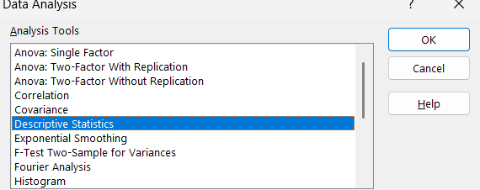
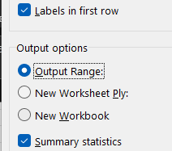
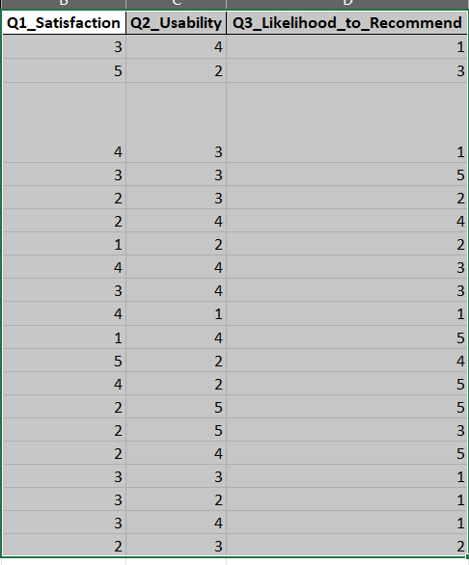
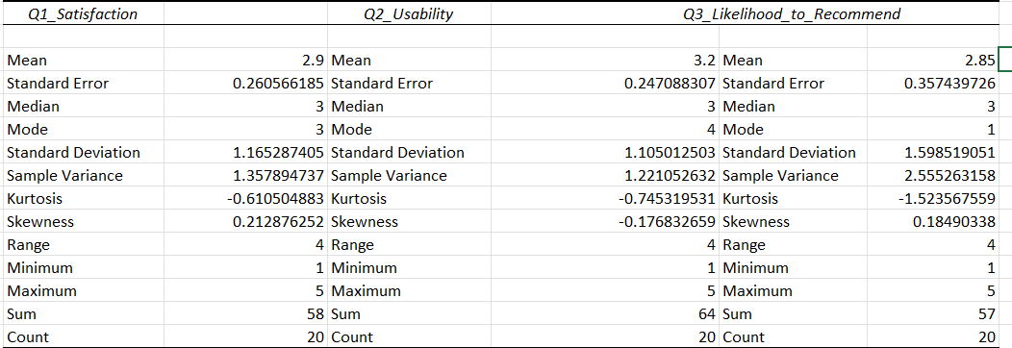
Descriptive statistics for Likert Data
Select Likert-data; you can even choose multiple question together
You can delete Standard error and variance, kurtosis, skewness, and sum. You may also fix the aesthetics

Slide 13
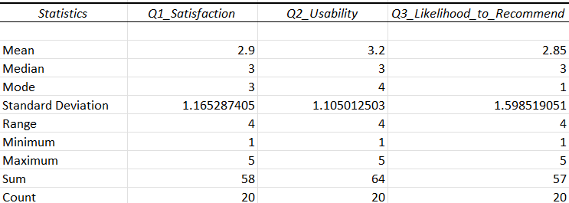
Example: better aesthetics

Slide 14
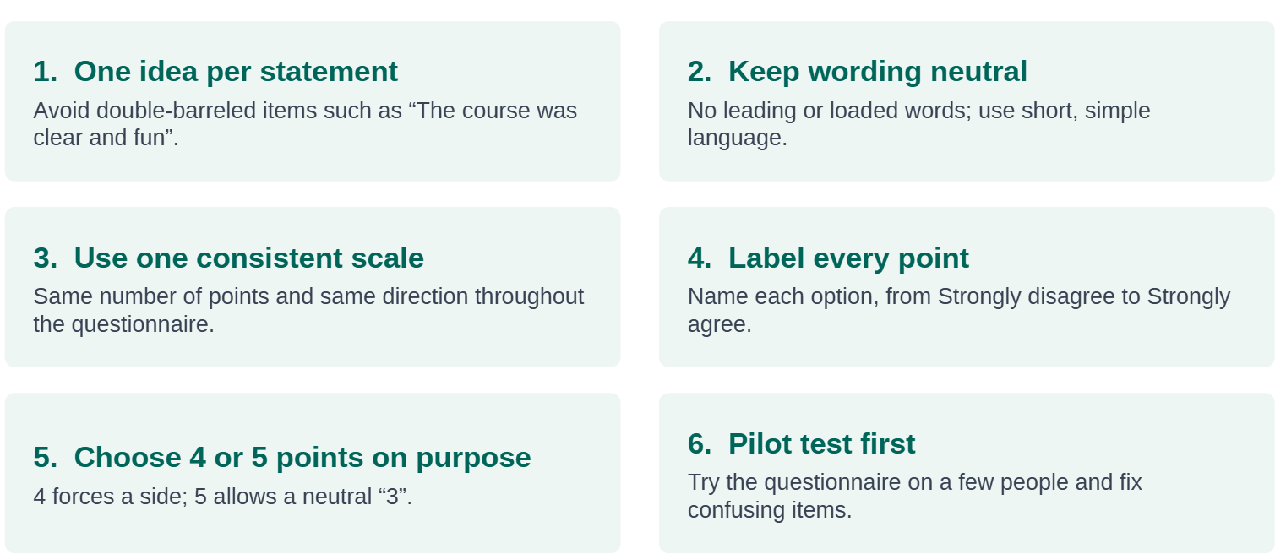
Tips for questionnaire design with Likert-scale
Good example: To what extent do you agree that the earth is flat? Rate from 1=? to 5=?
Bad example: Don’t you think the earth is spherical? (Leading)
Don’t you think the earth is not spherical? (Double negative)

Slide 15
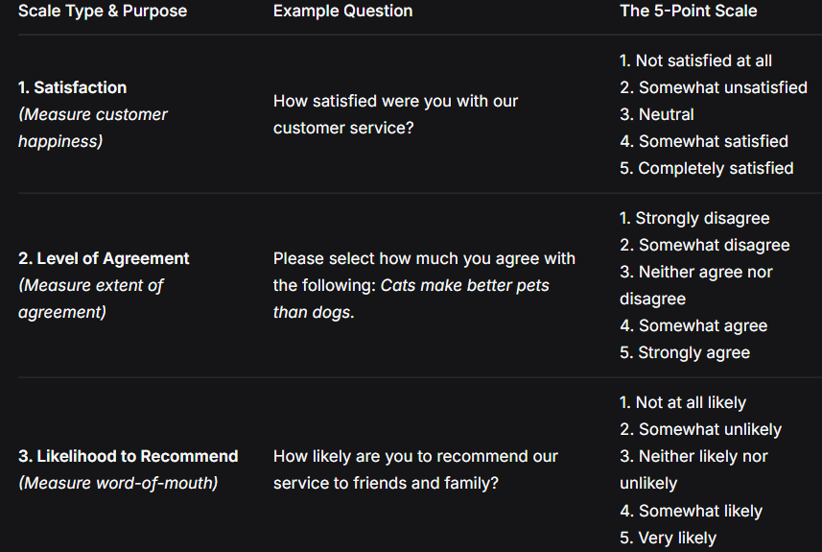
Likert Scale Questions

Slide 16
Constructs VS Questions
Construct
Items/Questions
Question Description:
Please indicate your level of agreement with the following statements regarding the bank chatbot. 1= strongly disagree to 5=strongly agree
(Statements):
I am pleased with the bank chatbot. (1 to 5)
I am happy with the bank chatbot. (1 to 5)
I think the bank chatbot is satisfactory.(1 to 5)

Slide 17
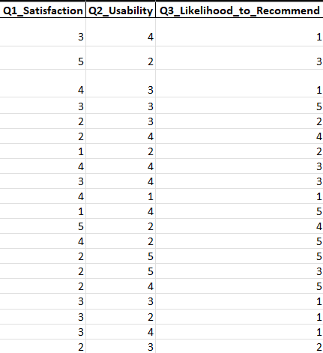
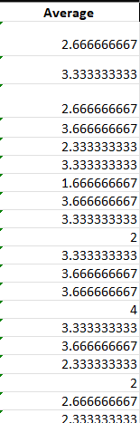
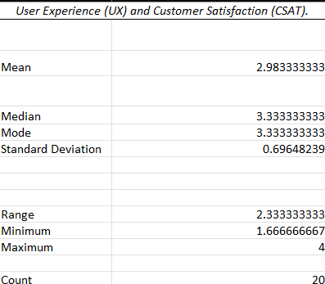
Excel: Construct based averaging with Descriptive Statistics
Row average and Use the red data for descriptive
statistics for the construct
Source: Completed Work.xlsx, sheet Likert_scale

Slide 18
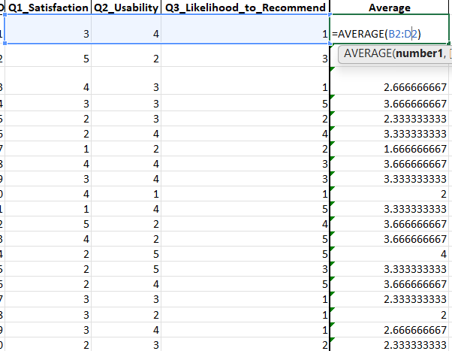
How To:

Slide 19
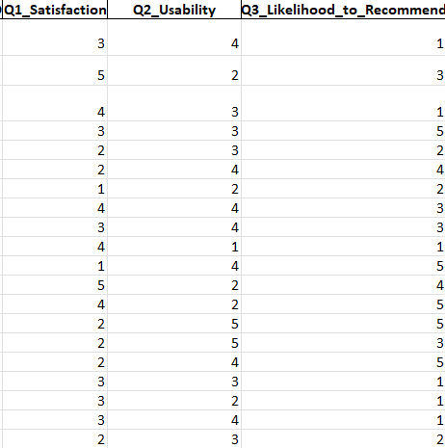
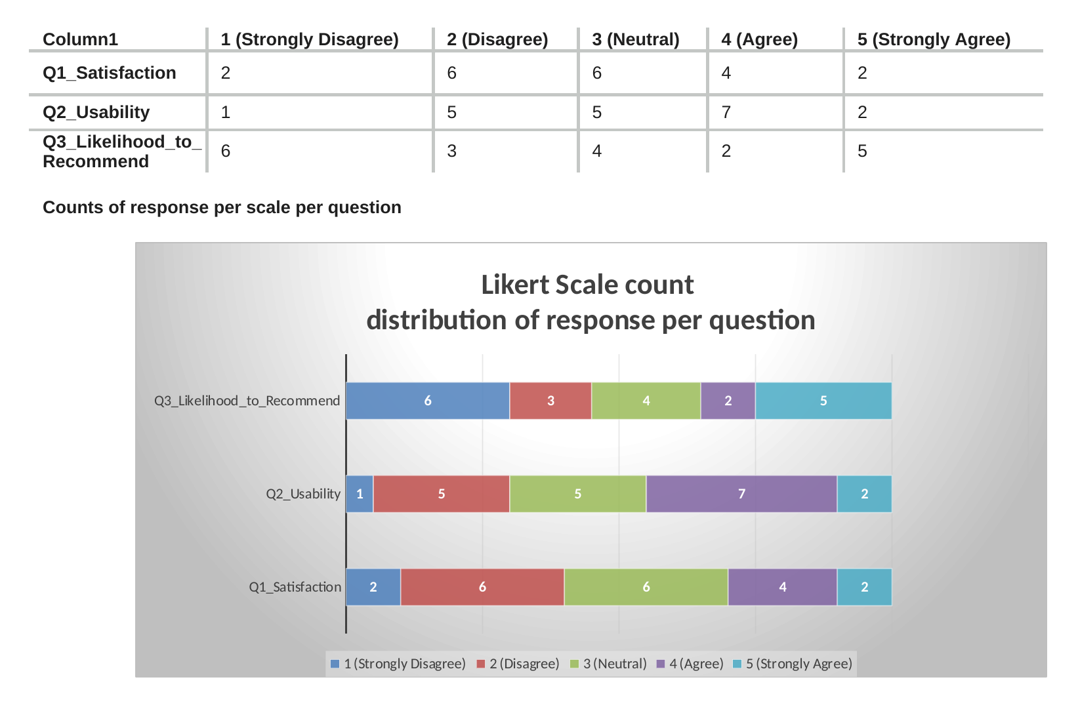
Excel: Likert Scale Summaries
Transform from first table to the next and use COUNTIF counts per answer,
Source: Completed Work.xlsx, sheet Likert_scale

Slide 20
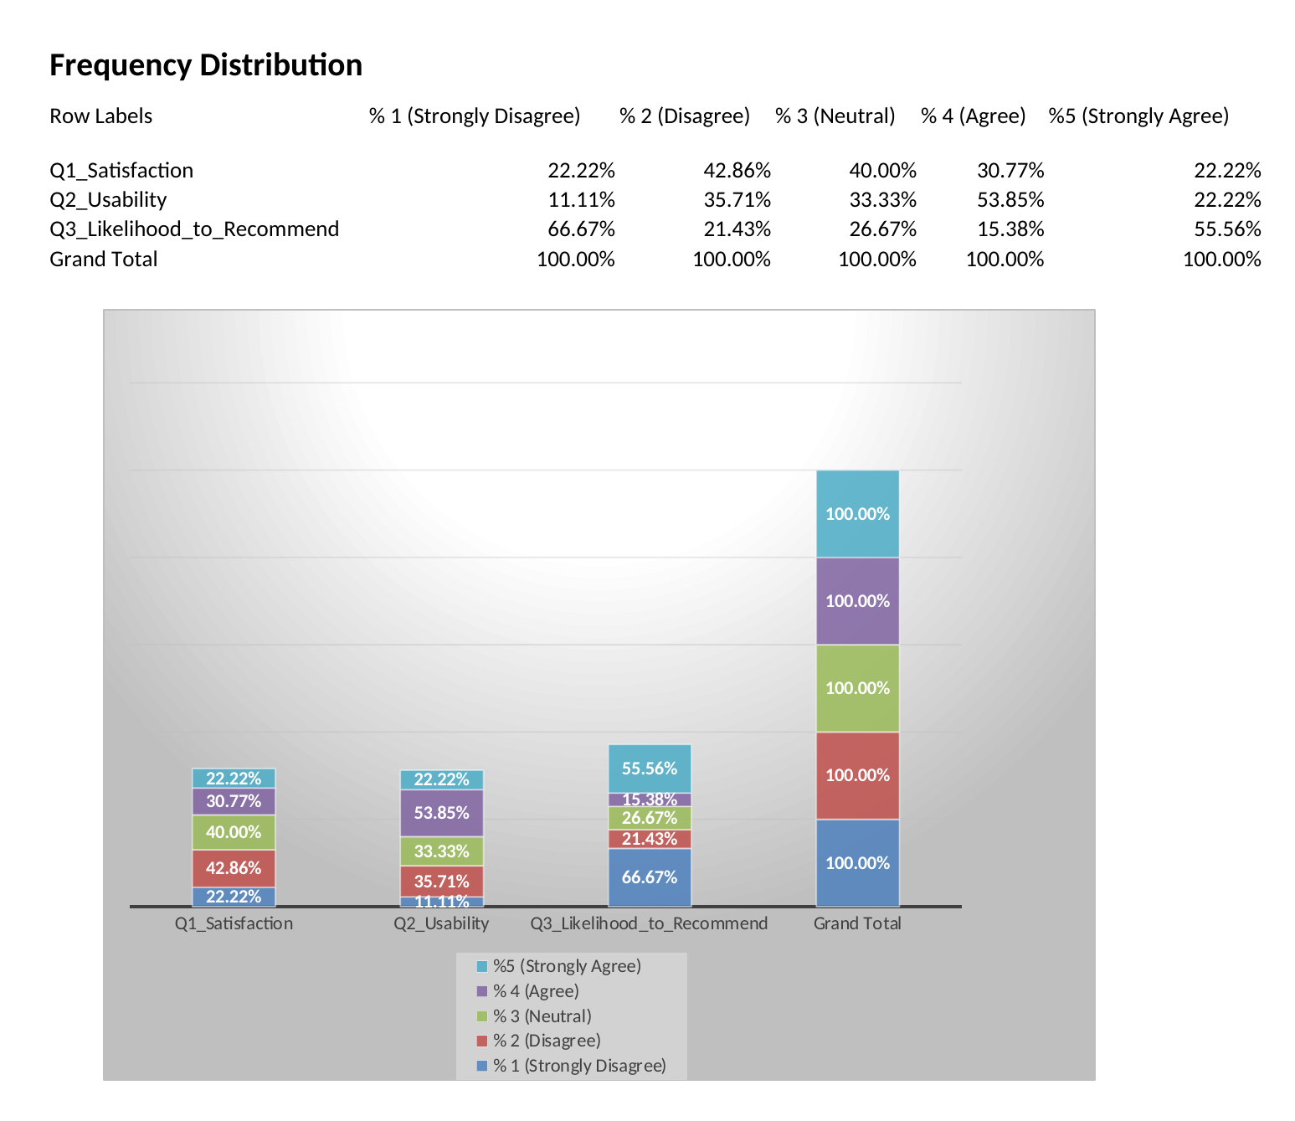
Excel: Likert Scale Summaries
COUNTIF counts per answer, then a PivotTable of percentages, each with a stacked chart
Source: Completed Work.xlsx, sheet Likert_scale

Slide 21
Hypothesis Testing
A difference is good, and if you think there is a difference, but the test shows there isn’t, find out why?
Both offer valuable findings!
Still, it may be due to sample size or complexity of the topic
Be rational and simple in what you want to measure and test!

Slide 22


Parametric and Non-parametric tests on normal data
Non-parametric thrives in non-normal data
Rely on the median, IQR, and non-parametric tests with Spearman correlation
Non-parametric tests handle outliers easily, works with small sample but have lower power
Second alternative if we can’t use parametric
Parametric thrives in normal data
Rely on the mean (average), standard deviation, and parametric tests with Pearson correlation
Parametric tests have higher power, but are sensitive to outliers
Needs higher samples; otherwise use non-parametric

Slide 23
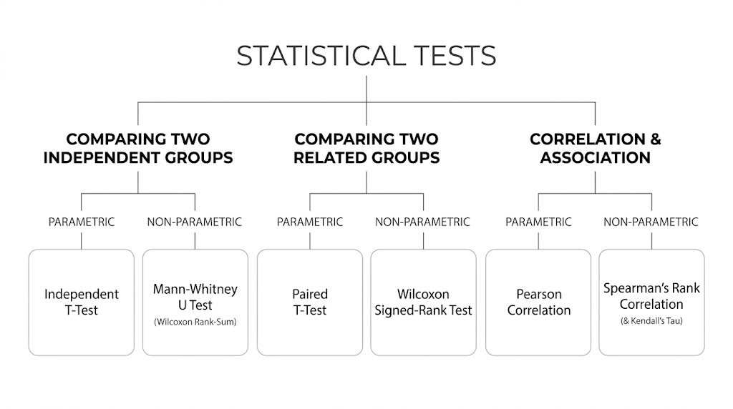
Types of Hypothesis Tests
Parametric for normal data
Non-parametric for non-normal data such as Likert scale
p-value: lower than the chosen p, groups are different
Significant results aim to “reject H0 (Null Hypothesis)”.
Insignificant results shows that “we failed to reject H0”.
H0: There is no significant difference between these groups
H1: There is a significant difference between these groups

Slide 24
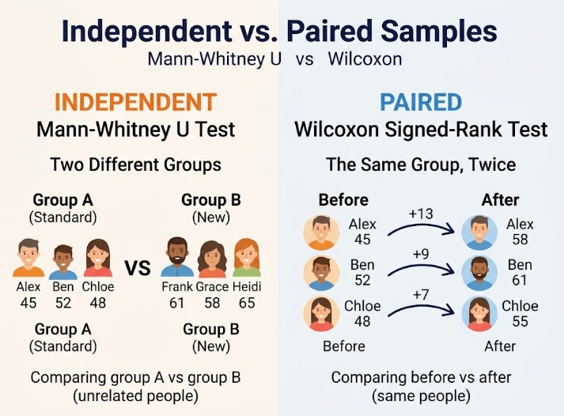

Slide 25
The 4 Hypothesis Tests and Their Parameters
Pick the test by data type and group design, then interpret with p, α, and an effect size
Test | Use when | Statistics | Effect size: small / med. / large
Independent t-test | Normal data; when people are different geographically, from gender, or with unique characteristics. 30 vs 30 | t score >+/-2 | d = 0.20 / 0.50 / 0.80
Paired t-test | Normal data; use same people in pre-survey and match them with post-survey after intervention. Minimum sample size is 30 | t score >+/-2 | d = 0.20 / 0.50 / 0.80
Mann-Whitney U | Non-normal or Likert data; when people are different geographically, from gender, or with unique characteristics. Each group must have same sample size. Minimum 30 for each group | U-score/ z> +/-2 | r = 0.10 / 0.30 / 0.50
Wilcoxon signed-rank | Non-normal or Likert data; use same people in pre-survey and match them with post-survey after intervention. Minimum sample size is 30 | W-score/ z>+/-2 | r = 0.10 / 0.30 / 0.50
Set significance at 5%, because 1% significance needs a very large sample but more robust
p-value must be below 5% or 0.05 for statistical difference
Effect size says how large is this difference between the groups as seen in table
Aim for 100 sample size
U and W score must be reported in your results; they have no contextual meaning for you to think about.

Slide 26
Problems with Wilcoxon Signed-Rank Test
Plan the design before collecting data: two surveys, matched participants
2 surveys and an intervention
Survey 1, then an intervention after it: a workshop, a campaign, anything that feels like an event you implemented, or a phenomenon that changed your participants’ perception of your topic. Then send Survey 2 to assess the change. Survey 2 could remain the same questions or add a prompting sentence with your original question e.g., after this intervention, how would you now respond?
Expect dropouts
Dropouts are very likely: aim for 100 participants, because up to 60% may drop out or not continue for Survey 2. You need at least 30 matched pairs for this test.
How to match
Depending on your course policy, you may use participants’ email to communicate and match them for the test. Otherwise, if email is for communication only, use another technique, such as giving each participant one unique ID, counting from 1 to infinity without reusing a used number from a dropped participant. (Recommended for Google Colab)

Slide 27
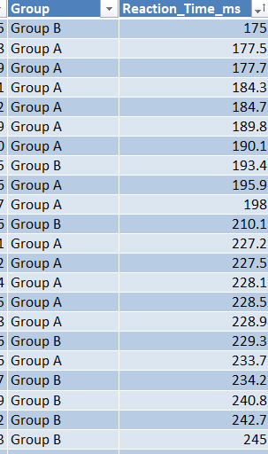
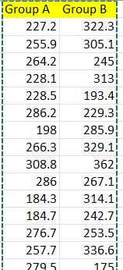
Excel: Independent t-test (not required for project)
Source: Completed Work.xlsx, sheet Independent_Groups_Data (ToolPak output)

Slide 28
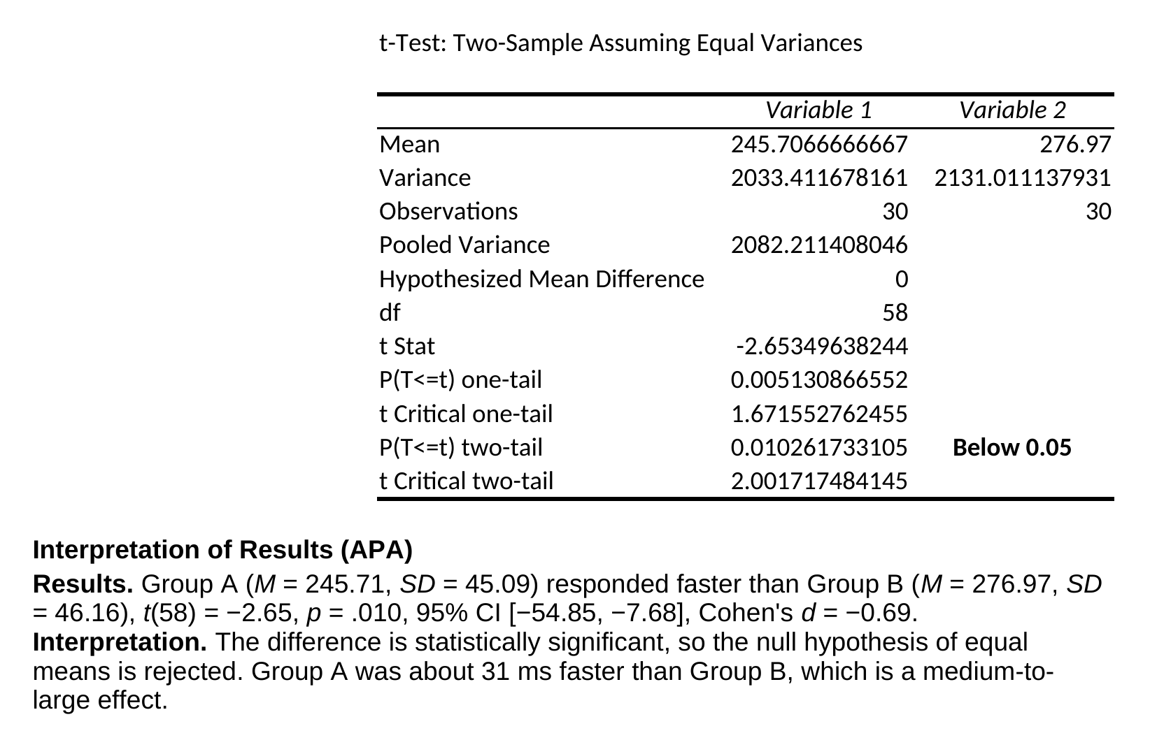
Excel: Independent t-test (not required for project)
t-Test: Two-Sample Assuming Equal Variances, Group A vs Group B (p = 0.01)
Source: Completed Work.xlsx, sheet Independent_Groups_Data (ToolPak output)

Slide 29
AI Prompt for a Mann-Whitney U test (Google Colab)
Perform a Mann-Whitney U test to compare the distributions of the independent groups in my dataset. I have Likert-Scale questions, which each needs a Mann-Whitney U test. Significance 5%
For the final presentation of the results, construct a pandas DataFrame and display it without row index numbers using .style.hide(axis="index").
Ensure the DataFrame is organized side-by-side with exactly this column structure:
- Metric: Rows in this order: N, Median, IQR, U-statistic, z-score, p-value, Effect Size (r).
- [Name the group]: Containing N, Median, and IQR written as [Q1, Q3] for Group A. Leave the other rows blank.
- [Name the group]: Containing N, Median, and IQR written as [Q1, Q3] for Group B. Leave the other rows blank.
- Test Statistics / Overall: Dedicated column for overall results containing the U-statistic, z-score, p-value (APA format, no leading zero), and the effect size (r) calculated as |z| / √N, where N is the total number of observations in both groups. Leave the N, Median, and IQR rows blank.
Use empty strings, not NaN, for blank cells, and display the table itself, not a text summary.
SPSS: https://youtu.be/OBw-8g5qjF8?si=TPbi1FOrh5O6Gc_p

Slide 30
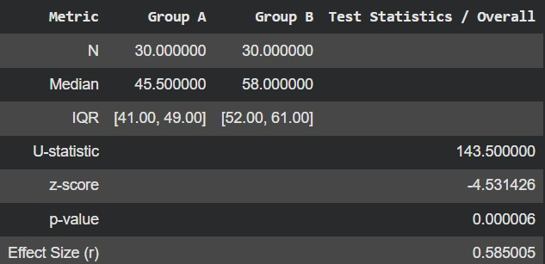
Output
A Mann-Whitney U test showed that Group B (Mdn = 58.00, IQR [52.00, 61.00]) scored significantly higher than Group A (Mdn = 45.50, IQR [41.00, 49.00]), U = 143.50, z = −4.53, p < .001, r = .59, indicating a large effect (n = 30 per group).

Slide 31
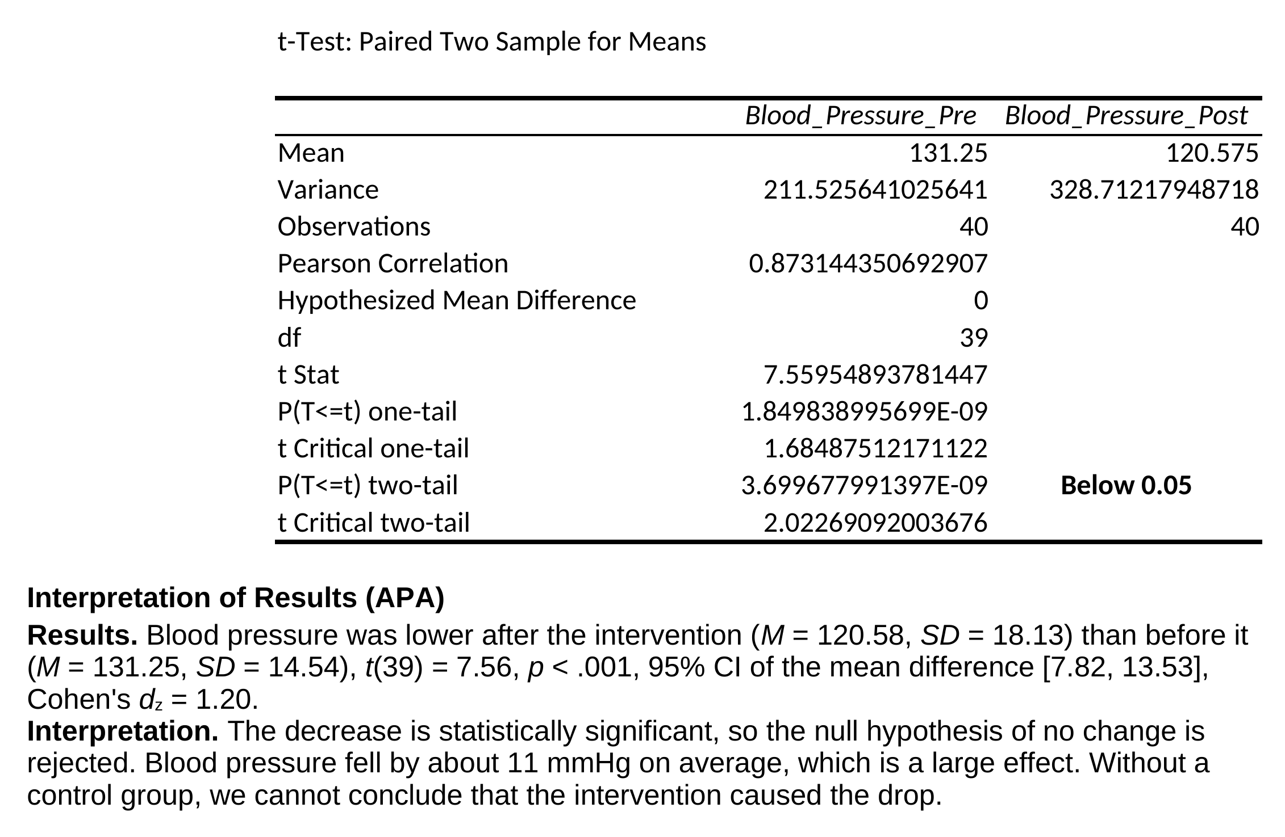
Excel: Paired t-test (not required for project)
t-Test: Paired Two Sample for Means, pre vs post blood pressure (p < 0.001)
Source: Completed Work.xlsx, sheet Paired_Groups_Data (ToolPak output)

Slide 32
AI Prompt for Wilcoxon Signed-Rank (Google Colab)
Perform a Wilcoxon Signed-Rank test comparing the paired pre-intervention and post-intervention distributions in my 2 excel files/sheets. I have Likert-Scale questions, which each needs a Wilcoxon Signed-Rank test. At 5% significance.
For the final presentation of the results, construct a pandas DataFrame and display it without row index numbers using .style.hide(axis="index").
Ensure the DataFrame is organized side-by-side with exactly this column structure:
- Metric: Rows in this order: N, Median, IQR, W-statistic, z-score, p-value, Effect Size (r).
- Pre-Test: Containing N, Median, and IQR written as [Q1, Q3] for the pre-intervention group. Leave the other rows blank.
- Post-Test: Containing N, Median, and IQR written as [Q1, Q3] for the post-intervention group. Leave the other rows blank.
- Test Statistics / Overall: Dedicated column for overall results containing the W-statistic, z-score, exact p-value (APA format, no leading zero), and the effect size (r) calculated as |z| / √N, where N is the total number of observations across both timepoints. Leave the N, Median, and IQR rows blank.
Use empty strings, not NaN, for blank cells, and display the table itself, not a text summary.
SPSS: https://youtu.be/gHEq3Lps1tQ?si=sGKMVZeq6ExaQGL2

Slide 33
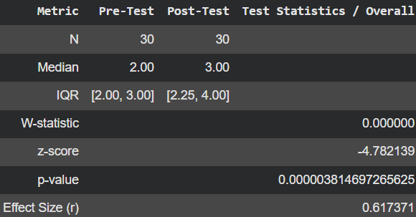
Output
A Wilcoxon signed-rank test also showed a significant increase from pre-test (Mdn = 2.00, IQR [2.00, 3.00]) to post-test (Mdn = 3.00, IQR [2.25, 4.00]), W = 0.00, z = −4.78, p < .001, r = .62, again indicating a large effect (N = 30).

Slide 34
One output per question
So, if you have 5 Likert questions, you will get 5 Wilcoxon Signed-Rank or
Mann-Whitney U outputs.
Your job is to select the most relevant results for your project;
You will be praised based on synthesis and quality, not quantity of outputs.
This applies to any other technique explained.

Slide 35
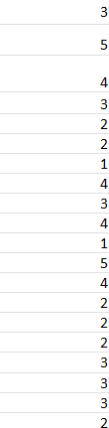

Mann-Whitney U test (groups of two category)
Q1 Female
Q1 Male
Q2 Male
Q2 Female
Etc... For Q3, Q4…
One Survey
Min 30 per group
Make sure of this, or collect more data till you reach 30 vs 30
You cannot compare Q1 and Q2, each alone

Slide 36
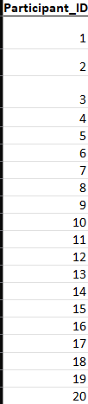

Wilcoxon Signed-Rank (pre-vs-post
Give them an ID, tell them to write in the forms
Q1 Post-test
Q1 pre-test
Q2 pre-test
Q2 post-test
Etc... For Q3, Q4…
Two Survey
Min 30 sample and same people
They need to be matched with an ID
You cannot compare Q1 and Q2,

Slide 37
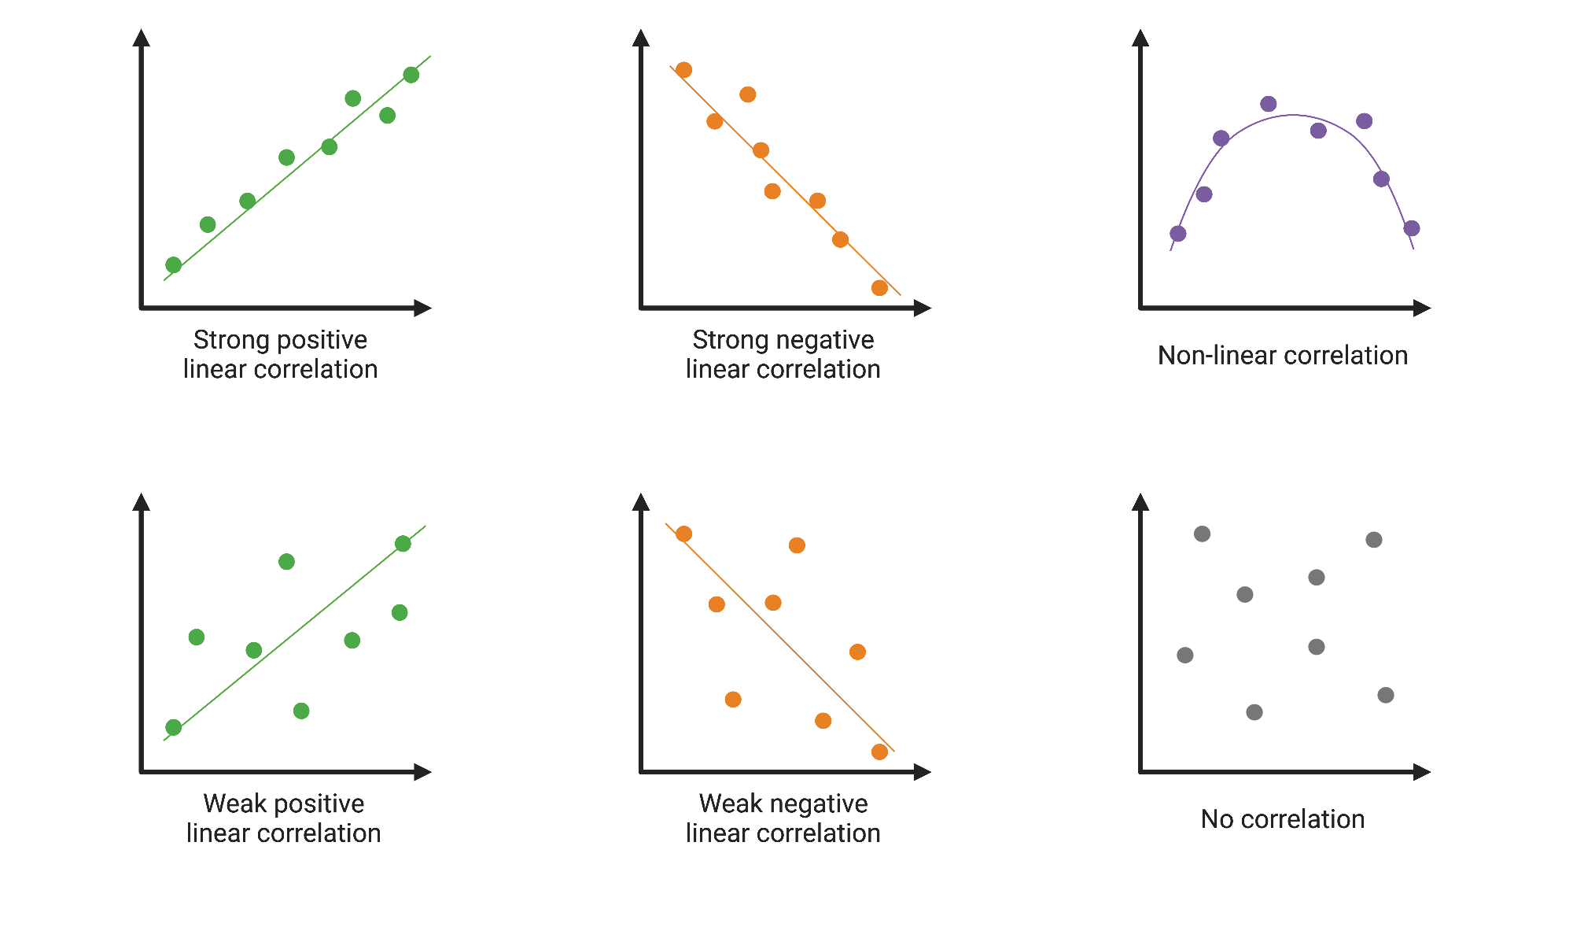
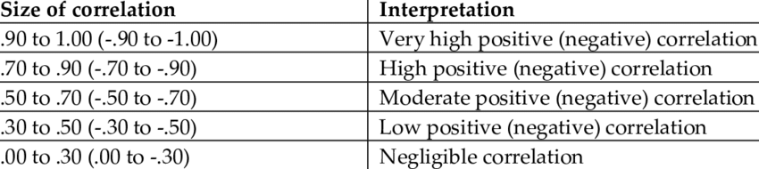
Correlation r:Pearson, or ρ (rho): Spearman
Check how it looks
Check what the number means
Will build a correlation matrix

Slide 38
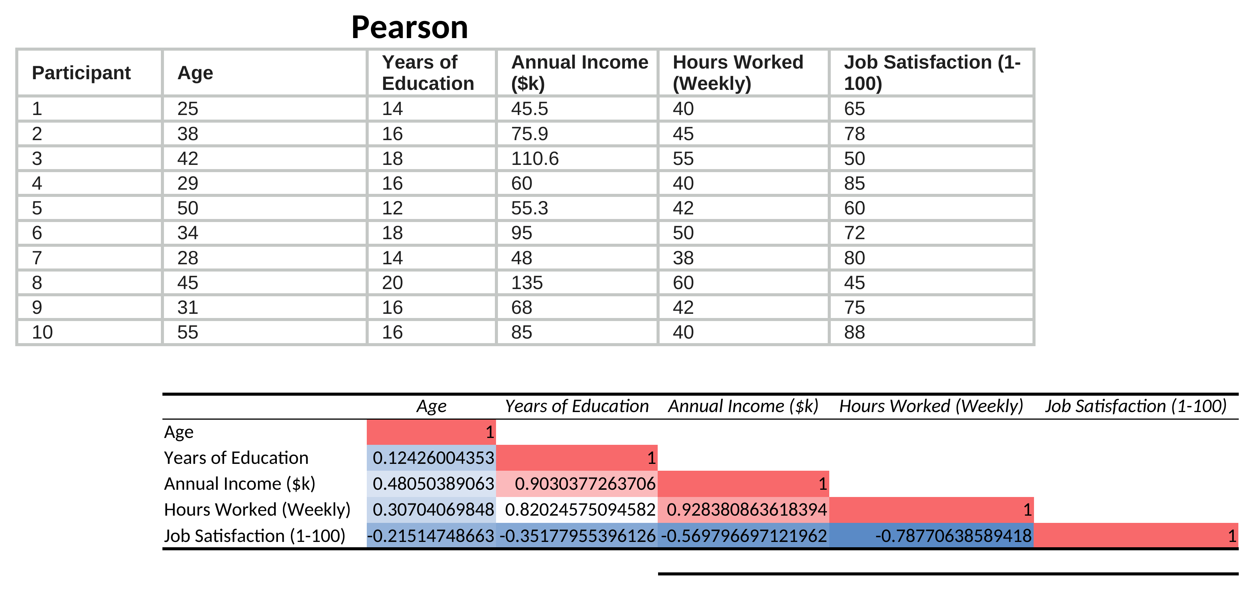
Excel: Pearson Correlation Matrix
Data Analysis ToolPak › Correlation, with a three-color scale on the matrix
Source: Completed Work.xlsx, sheet Correlation_Data (ToolPak output)

Slide 39
AI Prompt for Correlation Matrix (Google Colab)
Perform Pearson or Spearman correlation matrix plot, with neat squared shaped and tidy matrix with colors shade of blue and red, spacious for correlation to be seen among the variables:
The variables are:
-
-
-
Perform Point-Biserial(Pearson) or Rank-Biserial (Spearman) correlation matrix plot with target variable: [Name the target] with other variables in the correlation matrix, with neat squared shaped and tidy matrix with colors shade of blue and red, spacious for correlation to be seen among the variables, which are:
-
-
-

Slide 40
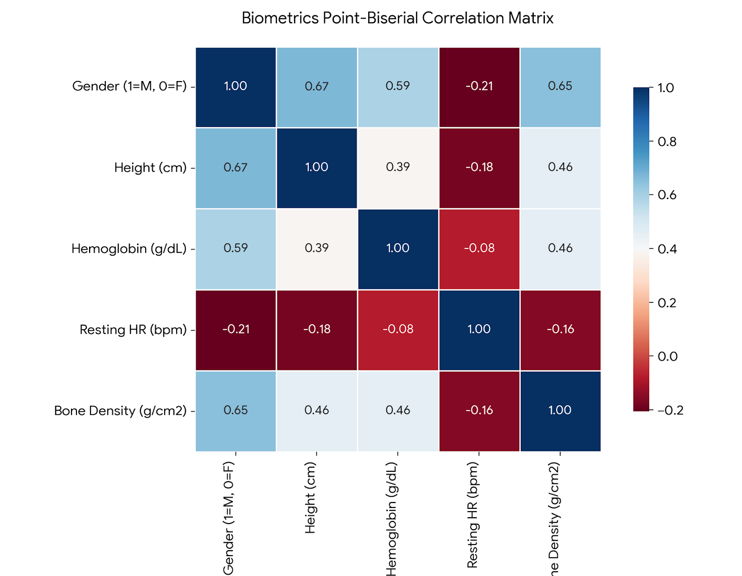
Positive for male since M=1
Negative for female since F=0
Dependent Variable
If you reverse,
sign logic reverses
Independent
variables

Slide 41
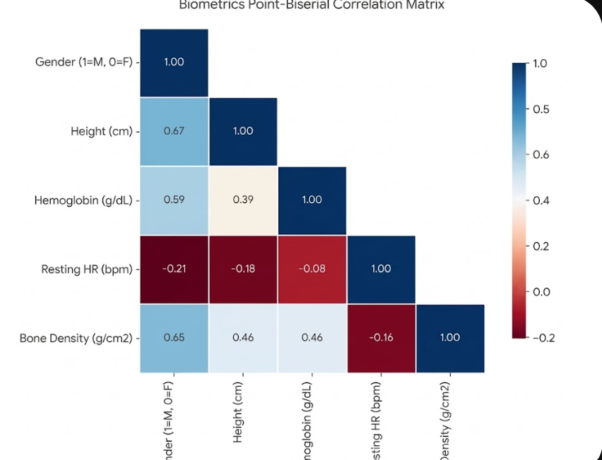

Slide 42
Summary of techniques you may use for Likert Scale Data analysis
Descriptive Statistics (n, Mean, Median, Mode, SD, Min, Max)
Construct based averaging with Descriptive Statistics
- Frequency Distribution with stacked bar chart
Mann-Whitney U test for Likert-Scale Questions
Wilcoxon Signed-Rank for Likert-Scale Questions
Spearman Correlation matrix for Likert-Scale Questions
Rank-Biserial Correlation matrix (spearman
with a binary target categorical variable).

Slide 43
+961 76359425

Slide 44
Results Section: How to Report Each Statistic (FYI)

Slide 45
Reporting Descriptive Statistics
Report n, M, SD, Mdn, Mode, Min and Max for each Likert item (1–5 scale)
Mean and SD
Template: M = x.xx, SD = x.xx
Example: Workload fairness was rated M = 3.12 (SD = 1.05).
Median, IQR and Mode
Template: Mdn = x.xx, IQR = x.xx, Mode = x
Example: Course clarity was rated Mdn = 4.00 (IQR = 1.00), Mode = 4.
Table 1
Descriptive Statistics for Likert Items on a 1–5 Scale (N = 120)
Item | n | M | SD | Mdn | Mode | Min | Max
Q1. The course was clear | 120 | 3.98 | 0.91 | 4.00 | 4 | 1 | 5
Q2. The workload was fair | 120 | 3.12 | 1.05 | 3.00 | 3 | 1 | 5
Q3. Feedback was timely | 120 | 2.31 | 1.12 | 2.00 | 2 | 1 | 5
Q4. I would recommend it | 120 | 3.74 | 1.02 | 4.00 | 4 | 1 | 5
Illustrative values for formatting only; replace with your own output. Give the scale anchors (1 = Strongly disagree, 5 = Strongly agree), use two decimals, and state N in the table title.

Slide 46
Reporting Construct Scores (Averaged Items)
Average each participant’s items into one construct score, then report it like a descriptive
Construct score
Report n, M, SD, Mdn, Mode, Min, Max
Items of one construct
Row average per
participant (1–5)
Name the items
List which questions form the construct
In-text template
Course experience (3 items) was rated moderately high (M = 3.71, SD = 0.68, Mdn = 3.67).
State the items averaged and the scale (1–5), and keep the same decimals.
Table 2
Descriptive Statistics for Constructs (Row-Averaged Items)
Construct | Items | M | SD
Course experience | 3 | 3.71 | 0.68
Instructor support | 4 | 3.42 | 0.77
Engagement | 5 | 3.15 | 0.83
Illustrative values for formatting only; replace with your own output.

Slide 47
Reporting Frequency Distributions
Show counts (n) and percentages (%) for each Likert response, with a total row
Table 3
Frequency of Responses to Q1. The course was clear (N = 148)
In-text template
Most respondents agreed the course was clear (n = 71, 48.0%), followed by strongly agreed (n = 38, 25.7%).
Give n first, then the percentage, to one decimal.
Response | n | % | Cumulative %
Strongly disagree | 5 | 3.4 | 3.4
Disagree | 10 | 6.8 | 10.1
Neutral | 24 | 16.2 | 26.4
Agree | 71 | 48.0 | 74.3
Strongly agree | 38 | 25.7 | 100.0
Total | 148 | 100.0
Choosing the chart
Horizontal stacked bar for Likert items
One bar per item, 0–100%, colors in scale order
Keep response options in their natural order
Counts come from your COUNTIF table. Percentages may not add to exactly 100.0 because of rounding; say so in a table note.

Slide 48
Reporting Likert Items with a Stacked Bar
Report median, IQR, and the percentage choosing each side of the scale
Table 4
Item Responses on a 1–5 Scale (1 = Strongly disagree, 5 = Strongly agree)
Item | Mdn | IQR | Disagree (1–2), % | Neutral (3), % | Agree (4–5), %
Q1. The course was clear | 4 | 1 | 10 | 14 | 76
Q2. The workload was fair | 3 | 2 | 29 | 33 | 38
Q3. Feedback was timely | 2 | 1 | 62 | 21 | 17
Example: Most participants agreed the course was clear (Mdn = 4, IQR = 1; 76% chose 4 or 5).
Do
Give the scale anchors and direction
Show % for each response option
Use a diverging stacked bar for many items
Avoid
M and SD for a single Likert item
Pie charts for ordered categories
Leaving the response options unordered

Slide 49
Reporting Hypothesis Tests (p, α)
State α in advance, report the exact p-value, and add an effect size
Significance level (α)
Set α before testing (.10, .05, or .01) and state it once. If p < α, reject H₀ (groups differ).
Exact p-value
Write p = .016, not p < .05. Use p < .001 for very small values. No leading zero, never p = .000.
Effect size
Pair every p with an effect size: r for the rank tests (.10 small, .30 medium, .50 large).
Wording
Significant: “The groups differed significantly, p = .016, r = .31 (medium).”
Not significant: “The groups did not differ significantly, p = .412, r = .08.”

Slide 50
Reporting the Mann-Whitney U Test
Two independent groups, Likert data (the Mann-Whitney U Google Colab prompt output)
Table 5
Mann-Whitney U Test Comparing Group A and Group B
Metric | Group A | Group B | Test statistics / overall
N | 30 | 30 | U = 287.0 z = −2.41 p = .016 r = .31
Mdn | 4.00 | 3.00
IQR | 1.00 | 2.00
In-text template
A Mann-Whitney U test showed higher scores for Group A (Mdn = 4.00, IQR = 1.00) than Group B (Mdn = 3.00, IQR = 2.00), U = 287.0, z = −2.41, p = .016, r = .31.
Checklist
Name both groups with n, Mdn, IQR
Give U, z, exact p, and r
State which group scored higher
Say N in r = |z| / √N is total
Report each Likert item or construct score with its own test sentence; name the groups and which scored higher.

Slide 51
Reporting the Wilcoxon Signed-Rank Test
Two related groups, pre and post (the Wilcoxon Google Colab prompt output)
Table 6
Wilcoxon Signed-Rank Test Comparing Pre-Test and Post-Test
Metric | Pre-test | Post-test | Test statistics / overall
N (pairs) | 25 | 25 | W = 56.5 z = −2.85 p = .004 r = .40
Mdn | 3.00 | 4.00
IQR | 1.50 | 1.00
In-text template
A Wilcoxon signed-rank test showed post-test scores (Mdn = 4.00, IQR = 1.00) were higher than pre-test scores (Mdn = 3.00, IQR = 1.50), W = 56.5, z = −2.85, p = .004, r = .40.
Checklist
State the number of pairs
Give Mdn and IQR at both times
Give W, z, exact p, and r
Here N = 50 (25 pairs × 2) in r
Report only participants who completed both surveys (matched by unique ID or email, per your course policy).

Slide 52
Reporting Spearman Correlations
Spearman ρ for Likert items and construct scores; no p-value or degrees of freedom needed
Recommended format
Spearman: ρ = .xx
Example: A low positive correlation was found between course clarity and satisfaction, ρ = .46.
Table 7
Interpreting the Size of ρ
Size (absolute) | Interpretation
.90 to 1.00 | Very high
.70 to .90 | High
.50 to .70 | Moderate
.30 to .50 | Low
.00 to .30 | Negligible
Always include
Both variable names and the method used
Direction and strength word; correlation is not causation
Before you report
Plot the scatterplot first: a curve can hide a real link. Negative values use the same bands.

Slide 53
Reporting a Rank-Biserial Correlation Matrix
A binary variable (gender) against Likert variables, as in the correlation heat map
Table 8
Rank-Biserial Correlations Between Gender and Likert Variables (N = [n])
Recommended practice
Show the lower triangle only; skip repeated 1.00 cells
State how the binary variable is coded
If Male = 1, positive is for Male, and Female = 0 gets the negative sign. The value shows the strength of the association.
Write “associated with”, not “predicts”
No p-value is needed
Variable | 1 | 2 | 3 | 4
1. Gender (1 = M, 0 = F) | —
2. Course clarity | .31 | —
3. Workload fairness | .18 | .39 | —
4. Feedback timeliness | −.21 | .28 | .12 | —
5. Satisfaction | .25 | .46 | .34 | .40
Example: Gender was positively associated with course clarity, r_{rb} = .31, and with satisfaction, r_{rb} = .25.

Slide 54
Quick Reference: One-Line Report Templates
One-line templates for every Likert technique in the deck
Statistic | Report as | Use when
Frequency | n = 71 (48.0%) | Each Likert response
Agree % | Agree (4–5) = 76% | Stacked bar summary
Mean and SD | M = 3.98, SD = 0.91 | Likert item
Median and IQR | Mdn = 4.00, IQR = 1.00 | Likert item
Mode, min, max | Mode = 4, Min = 1, Max = 5 | Likert item
Construct score | M = 3.71, SD = 0.68 | Averaged items
Mann-Whitney U | U = 287.0, z = −2.41, p = .016, r = .31 | Two independent groups
Wilcoxon signed-rank | W = 56.5, z = −2.85, p = .004, r = .40 | Two related groups
Spearman | ρ = .46 | Two Likert variables
Rank-biserial | r_{rb} = .31 | Binary × Likert
Italicize statistical symbols, use two decimals (three for p), and drop the leading zero for p and r (.016, not 0.016). No p-value or degrees of freedom for Spearman. Example values only.

